Slide 1
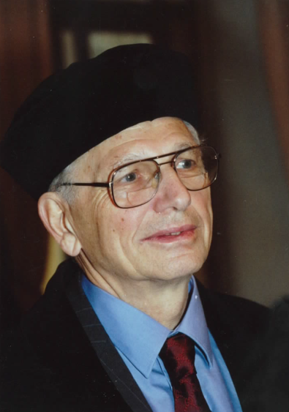
2014 Frederick Jelinek Memorial Workshop on Meaning Representations in Language and Speech Processing
Prague, July 7 – August 1, 2014
Charles University in Prague
Faculty of Mathematics and Physics
Computer Science School
Local organization by: Institute of Formal and Applied Linguistics
Malostranske nam. 25. 118 00 Prague 1, Czech Republic
http://www.clsp.jhu.edu/workshops/archive/ws14-summer-workshop
http://ufal.mff.cuni.cz/JHU-PIRE-workshop-2014

Slide 2
2014 Frederick Jelinek Memorial Workshop on Meaning Representations in Language and Speech Processing
9:00 | 9:05 | Workshop Inauguration | Jan Hajic
9:05 | 9:10 | Welcome to Charles University | Professor Tomas Zima, Rector of Charles University in Prague
9:10 | 9:15 | Welcome to the Faculty of Mathematics and Physics | Professor Jan Kratochvil, Dean of Faculty of Mathematics and Physics
9:15 | 9:35 | Workshop History and 2014 Goals | Sanjeev Khudanpur and John Godfrey
9:35 | 9:45 | Housekeeping Information | Jan Hajic, Zdenka Uresova and Ondrej Bojar
9:45 | 10:15 | Coffee Break | Outside the Refectory, 1st Floor
10:15 | 11:00 | ASR Team Goals and Preparations | Hynek Hermansky
11:00 | 11:45 | PRELIM Team Goals and Preparations | Jason Eisner and Benjamin Van Durme
11:45 | 12:30 | CLAMR Team Goals and Preparations | Daniel Gildea / Ondrej Bojar (in lieu of Martha Palmer)
End of Workshop opening
12:30 | 14:00 | Lunch | Cafeteria, Floor -1
14:00 | 15:00 | Team meetings | S10&S11, S8, S7
15:00 | 15:30 | First “Town Hall” meeting | S1
15:30 | 16:30 | Plenary lecture (public) | James Pustejovsky, S9
18:00 | 20:00 | Welcome dinner | Pivo & Basilico, Malostranske nam.

Slide 3
Logistics and contacts
Websites
Google “JHU CLSP Workshop” for program & people
Google “JHU UFAL Workshop” for logistics
Main contacts (housing, administration, local advice/problem solving)
Zdenka Uresova (uresova@ufal.mff.cuni.cz)
Katerina Stuparicova (stuparicova@ufal.mff.cuni.cz)
Program, technical
Sanjeev Khudanpur (khudanpur@jhu.edu)
Jan Hajic (hajic@ufal.mff.cuni.cz)
Main “home” for the Workshop
Office 412, 4th floor (turn left at top of staircase/elevator)

