Slide 1
Abstract Meaning Representation (AMR)
w
The boy wants to go
instance
ARG1
ARG0
g
want-01
b
ARG0
instance
instance
boy
go-01
(w / want-01
:ARG0 (b / boy)
:ARG1 (g / go-01
:ARG0 b))

Slide 2
Abstract Meaning Representation (AMR)
Basic “who-is-doing-what-to-whom”
Cover all sentence content in single, rooted structure, DAG
Builds upon PropBank
Uses PB rolesets: e.g. describe.01
Arg0: describer
Arg1: thing described
Arg2: secondary attribute, described-as
Adds more noun phrase structure, coreference and discourse structure

Slide 3
Abstract Meaning Representation (AMR)
AMR composed of concepts and relations, not nouns and verbs
Currently ~100 relations, plus inverses
AMR is not enslaved to syntax, or even mildly indentured:
He described her as a genius. (d / describe-01
As he described her, she is a genius. :ARG0 (h / he)
His description of her: a genius. :ARG1 (s / she)
:ARG2 (g / genius))

Slide 4
Aligning parallel corpora
Subtrees of dependency parses of parallel English/Chinese corpora only have isomorphic matches about 30% of the time.
Yuan Ding, Thesis, 2005
Parallel PropBank structures match almost 60%.
Wu & Palmer, SSST, 2011
What about AMR’s? Will they align even more?
Xue, Bojar, Hajič, Palmer, Urešová, Zhang, LREC 2014
<number><number>

Slide 5

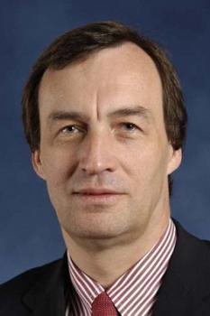
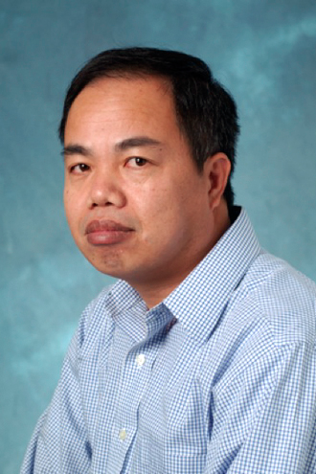
Meaning in AMR’s and Tectogrammatical Representation Interchange (MATRIX)
Martha Palmer
(Colorado)
Jan Hajic
(Charles)
Nianwen Xue
(Brandeis)
Zdenka Uresova (Charles)
Ondrej Dusek (Charles)
Tim O'Gorman (Colorado)
Ondrej Bojar (Charles)
<number><number>

Slide 6
MATRIX Questions
Meaning in AMR’s and Tectogrammatical Representation Interchange
How distant/similar are AMR’s and the Tectogrammatical Representation for English? Can we port the TR MT system to AMR’s?
How distant/similar are English AMR’s, Chinese, and Czech AMR’s?
Which differences have the most impact on the graph matching?
How much can deterministic reformatting of AMR’s bridge the distances?
<number><number>

Slide 7
Preparatory Efforts
English, Chinese, and Czech AMR’s of the same 100 sentences and their translations.
A preliminary mapping from TR to AMR.
Given a 1M word WSJ English corpus with parallel Czech translations, both in TR
And automatically produced AMR’s (from OntoNotes, thanks to Ulf Hermjakob) for the same data
<number><number>

Slide 8
Differences in Lexicalization and Annotation Choice 这 是 一 个 大 叫 “ 噢哦 ！ ” 的 时刻 。 This is a major `` D'oh! '' moment .
<number><number>
Notes:
These side-by-side graphs are from the paper, but are quite hard to read. The next few slides explain the important differences more clearly.
<number><number>

Slide 9
Annotation Choice Differences
Annotation choice
To reify or not to reify?
Chinese: reifies “be_temporally_located_at”
English drops “be” and puts “this” as the :domain of “moment”:
(m / moment
:mod (m2 / major)
:domain (t / this)
:mod (d / d'oh :mode expressive))
<number><number>

Slide 10
Alternatives Annotation Choices for English
English could just as easily reify “is moment” as temporal_location.01
(t / temporal_location.01
:Arg1 (t2 / this)
:mod (m / major)
:mod (d / d'oh :mode expressive))
English and Chinese would match more closely
How often is this the case?
<number><number>

Slide 11
Lexicalization differences
Language specific lexicalization differences
Simply different word choices
“major” vs. 叫/ cry
Often a single lexical item in one language is a multi-word expression elsewhere, w/ structure
“tells the tale” vs. popsány..
(t / tell.01 (p / popsat.1
:Arg1 (t2 / tale) (no :Arg1)
“překračovat povolenou rychlost” vs. “speeding”
Should AMR make more of an effort to treat MWE’s as single lexical items?
“Zácpa kolem čeho“
“Localized congestion around what”
<number><number>

Slide 12
Questions to investigate
If there are alternative annotation choices, can we deterministically produce them, resulting in better matches?
Where there are language-specific different lexicalizations, are there resources that could provide bi-lingual mappings?
How much should AMR abstract away from Multi-word expressions?
When to reify? And when not?
Etc.,
<number><number>

Slide 13

Graph-Based Parser for the Abstract Meaning Representation (JAMR)
Jeff Flanigan (CMU) Flanigan, Thomson, Carbonell, Dyer, Smith (ACL 2014)

Slide 14
JAMR Overview
Input
Concept Identification
Label sentence with concept fragments
Relation Identification
Connect fragments by adding relations

Slide 15
JAMR Overview
Input
Concept Identification
Label sentence with concept fragments
Relation Identification
Connect fragments by adding relations

Slide 16
JAMR Overview
Input
Concept Identification
Label sentence with concept fragments
Relation Identification
Connect fragments by adding relations
Relations = labeled directed edges

Slide 17
Concept Identification
Identify possible invoked concept fragments
Spans of words labeled with possible concept fragments

Slide 18
Concept Identification
Find best concept fragments labeling using dynamic programming

Slide 19
Relation Identification
Relation identification adds edges between nodes
Edge factored discriminatively trained model
Uses maximum spanning, connected, sub-graph algorithm (MSCG) with additional constraints
Notes:
<number><number>

Slide 20
Maximum Spanning Connected Sub-Graph Algorithm (MSCG)
Notes:
<number><number>

Slide 21
Maximum Spanning Connected Sub-Graph Algorithm (MSCG)
Graph must be deterministic
Notes:
Now we have added the labels and numbers because we have reduced the candidate edges
<number><number>

Slide 22
Enforce Constraint Using Lagrangian Relaxation

Slide 23
Results
JAMR available at http://github.com/jflanigan/jamr

Slide 24
Chinese AMR parsing
Nianwen Xue (Brandeis)
Chuan Wang (Brandeis)
Yuchen Zhang (Brandeis)
Wei-Te (Colorado)

Slide 25
Chinese AMR parsing
Data availability:
Only have AMR annotation for 100 sentences. Specifications still under development
But there is treebank and propbank annotation for over 1.5M words
So during the workshop we will be working on:
Producing pseudo AMRs based on the Chinese TreeBank and PropBank
Developing annotation specifications for Chinese AMRs
Developing a dependency tree to graph transition system, initially trained on English AMRs

Slide 26
Dependency Tree to Graph Transition System
A transition system is a quadruples S = (C, T, Cs,Ct), where
C is a set of parsing states (configurations)
T is a set of parsing actions (transitions), each of which is a function t: Ci→Cj
Cs is an initialization function, mapping a sentence and its dependency tree to an initial parsing state
Ct is a set of terminal parsing state

Slide 27
Parsing State
each parsing state is a triple c = (σ,β,Α), where
σ is a buffer of nodes initialized by bottom-up traversal of current sentence’s dependency tree dT, with buffer top i
β is a buffer of nodes which are children of current σ top i, with buffer top j
A is a partially parsed graph initialized with dependency tree dT
terminal state is ([],[],A)

Slide 28
Parsing Action
if β is not empty:
delete edge: (i|σ,j|β,Α) => (i|σ,β,Α.remove_edge(i,j))
swap: (i|σ,j|β,A) => (i|j|σ,β,A.swap(i,j))
replace head: (i|σ,j|β,A) => (j|σ,β=[i’s children except j],A.replace_head(i,j))
merge: (i|σ,j|β,A) => ((i<j)?i:j|σ,(i<j)?j:i|β,A.merge(i,j))
next: (i|σ,j|β,A) => (i|σ,β,A) # correct edge
β is empty:
add child k: (i|σ,[],A) => (i|σ,[],A.add_edge(i,k))
finish: (i|σ,[],A) => (t|σ,βt,A) # done with current node

Slide 29
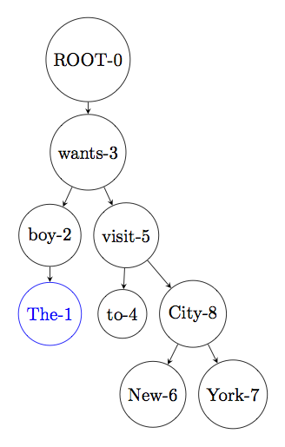
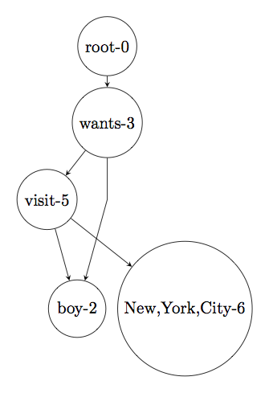
Example
σ:[The-1|σ]
β:[]
Finish

Slide 30
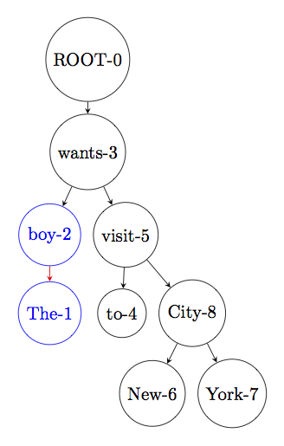
Example
σ:[boy-2|σ]
β:[The-1]
Delete child

Slide 31
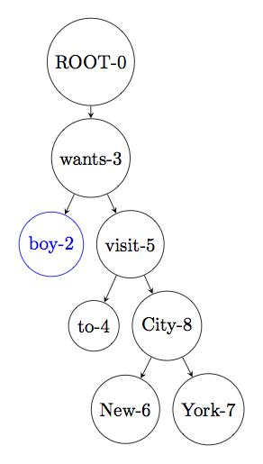
Example
σ:[boy-2|σ]
β:[]
Finish

Slide 32
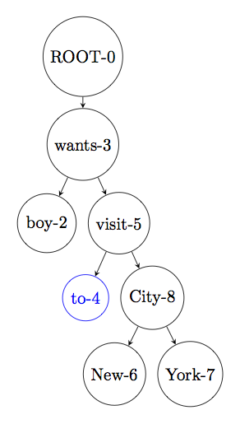
Example
σ:[to-4|σ]
β:[]
Finish

Slide 33
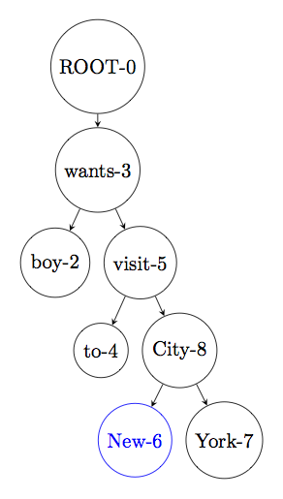
Example
σ:[New-6|σ]
β:[]
Finish

Slide 34
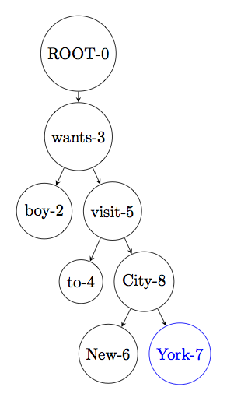
Example
σ:[York-7|σ]
β:[]
Finish

Slide 35
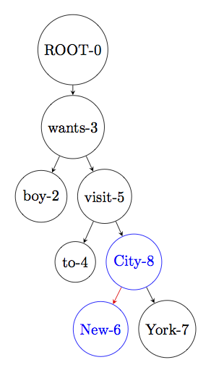
Example
σ:[City-8|σ]
β:[New-6|β]
Merge

Slide 36
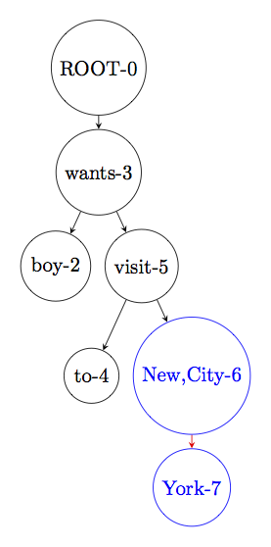
Example
σ:[New,City-6|σ]
β:[York-7]
Merge

Slide 37
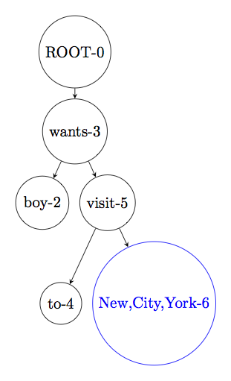
Example
σ:[New,York,City-6|σ]
β:[]
Finish

Slide 38
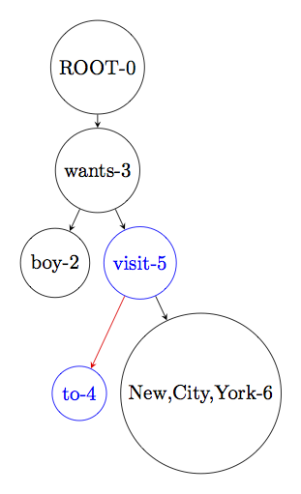
Example
σ:[visit-5|σ]
β:[to-4|β]
Delete child

Slide 39
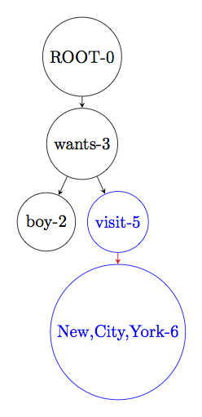
Example
σ:[visit-5|σ]
β:[New,York,City-6]
Next

Slide 40
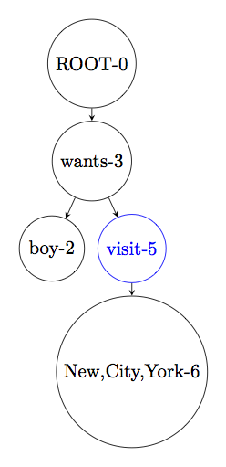
Example
σ:[visit-5|σ]
β:[]
Add child boy-2

Slide 41
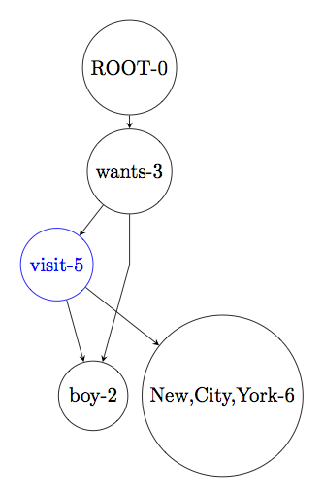
Example
σ:[visit-5|σ]
β:[]
Finish

Slide 42
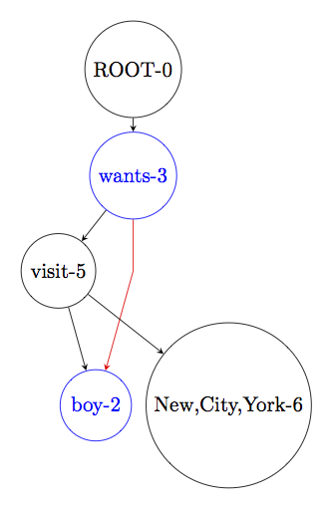
Example
σ:[wants-3|σ]
β:[boy-2|β]
Next

Slide 43
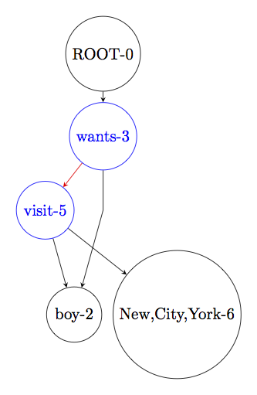
Example
σ:[wants-3|σ]
β:[visit-5]
Next

Slide 44
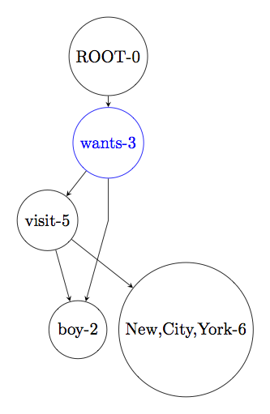
Example
σ:[wants-3|σ]
β:[]
Finish

Slide 45
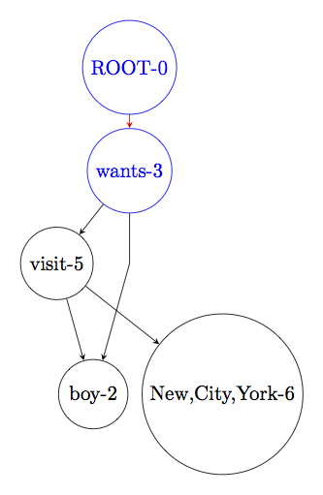
Example
σ:[Root-0|σ]
β:[wants-3|β]
Next

Slide 46
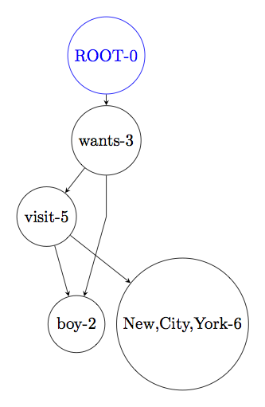
Example

Slide 47

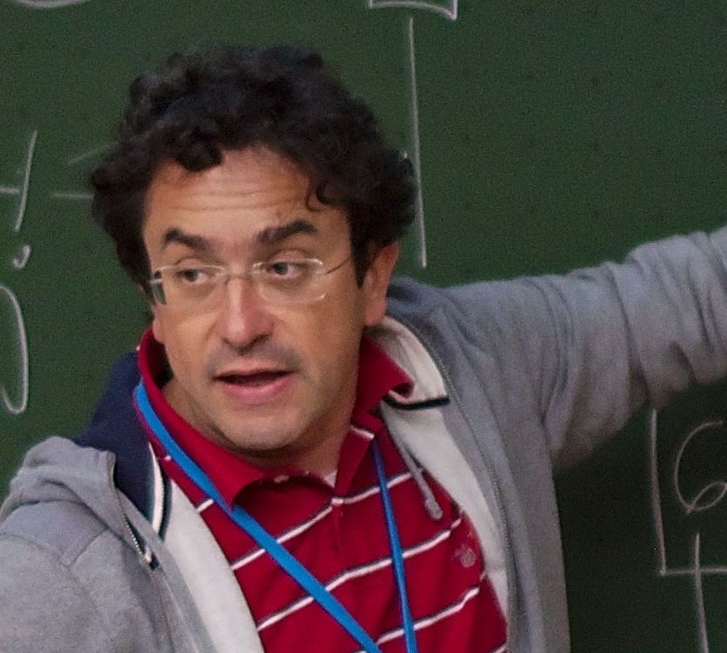
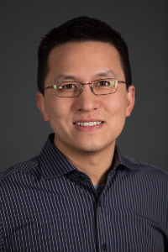
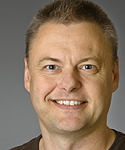
Graph Learning for AMR (GLAMR)
Dan Gildea (Rochester)
Giorgio Satta (Padova)
David Chiang (USC/ISI)
Frank Drewes (Umea)
Xiaochang Peng (Rochester)
Naomi Saphra (JHU)

Slide 48
Graph Learning for AMR (GLAMR)
Syntax-Based MT:
string → tree → string synchronous context-free grammar
Semantics-Based MT:
string → graph → string ?

Slide 49
Hyperedge Replacement Grammars (HRG)
Generalize Context-Free Grammars to generate graphs
Terminal and Nonterminal Hyperedges (Drewes et al., 1999)
Parsing graph with HRG:
O(((3^d)n)^(k+1)) (Chiang et al., ACL 2013)
n: size of graph
d: degree of graph
k: treewidth of grammar
Our goals this month:
Restricted formalism for NLP that is polynomial-time parsable
MCMC grammar learning

