Slide 1
Towards Machines Which Know When They Do not Know
Hynek Hermansky
The Johns Hopkins University

Slide 2
The problem is not what you do not know,
the problem is what you do not know that you do not know
white man
knowledge
native man
knowledge

Slide 3
speech
sounds
message
meaning
machine recognition of speech
training
assumption:
the world did not change since the machine was trained
“unknown unknowns” for the machine:
data distortions that were not seen in the training
words that are not in the lexicon of the machine
one possible solution:
on-line adaptation to new situations

Slide 4
Unsupervised adaptation
generative models
modify models to increase their likelihoods on unseen data
non-generative models (e.g. neural nets)
modify models so that the estimates still make sense ?????
Do the estimates make sense?
(Performance monitoring)
we know some characteristics of the expected estimates
estimates that are observed on the data on which the models were trained

Slide 5
training data
class
probability
estimator
output
descriptor
compare
estimate of
performance
test data
class
probability
estimator
output
descriptor

Slide 6
Problem Statement
classifier
of speech sounds
(phonemes)
posterior probabilities
of speech sounds
speech
Having a classifier that yields a frame based vectors of posterior probabilities for speech sounds of interest, predict the accuracy of these estimates without knowing the correct probabilities on test data but knowing performance of the classifier on the training data.

Slide 7
posteriogram
neural network
estimating
posteriors of
speech sounds
pre
processing
signal
Do not know the correct answer (ground truth)
Is the result good or bad?
How long does it take to get this info?

Slide 8
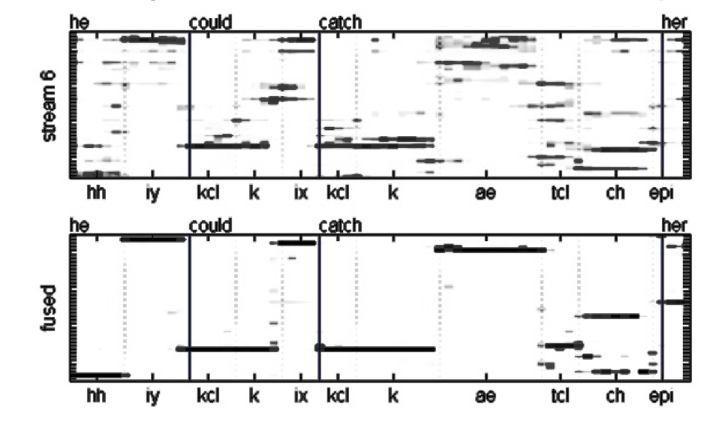

Slide 9
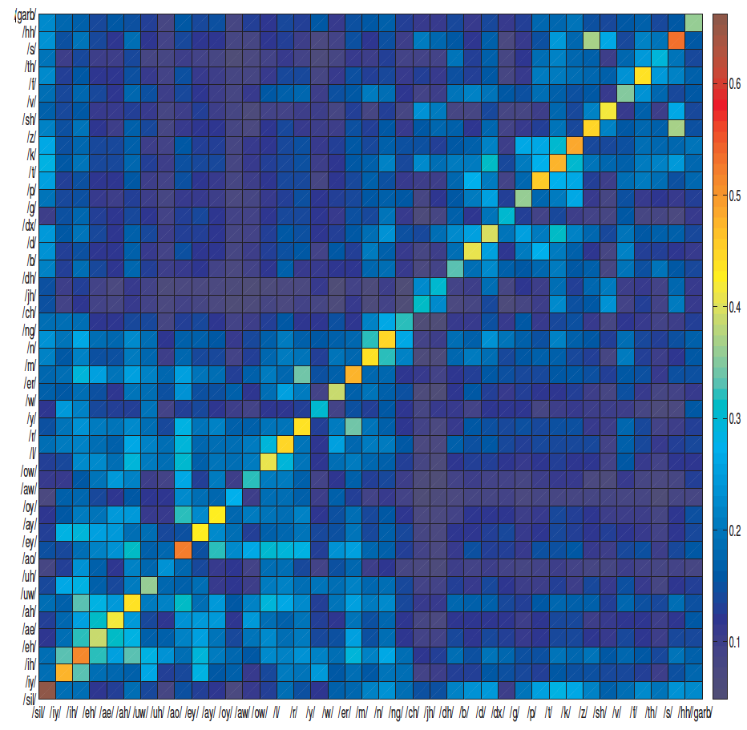
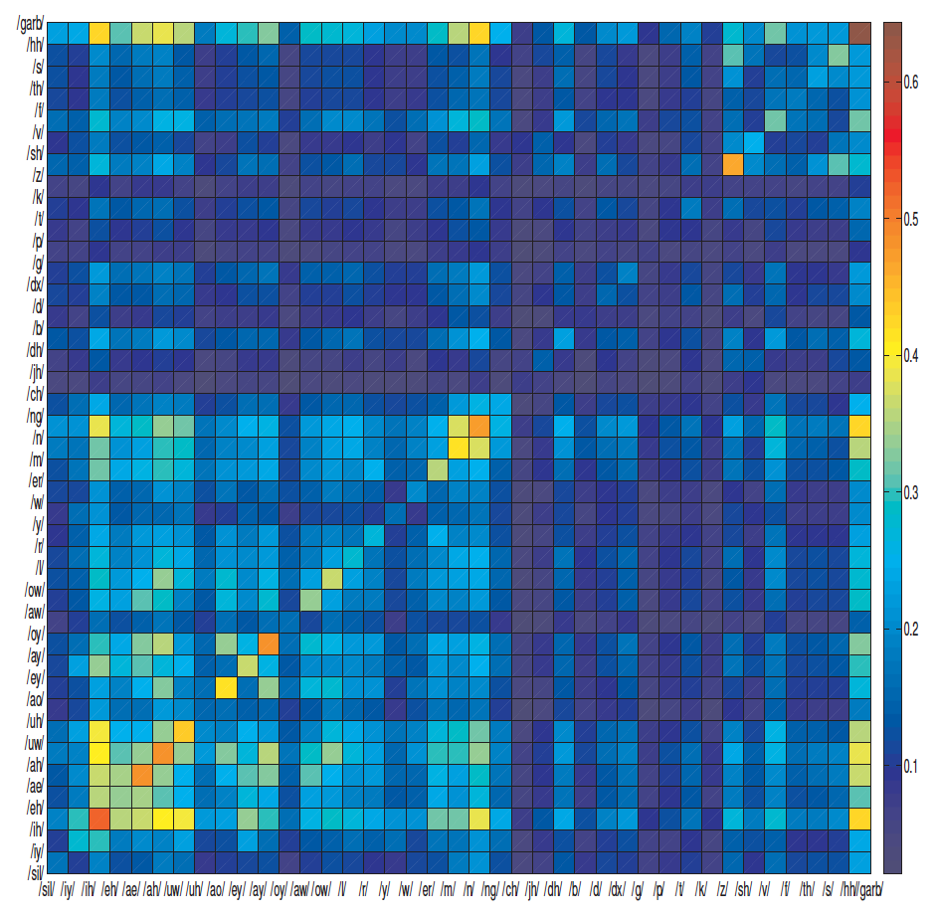
Evaluating Performance
How often sound classes occur and how often do they get confused?
p_{i} – vector of sound posteriors at i-th time instant
N – time interval of the evaluation
r – th power element-by-element (currently r=0.1)
clean data
noisy data
compare matrixes derived on training data and on test

Slide 10
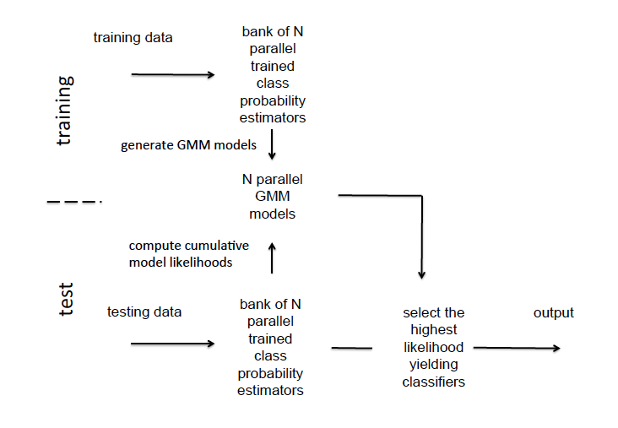

Slide 11
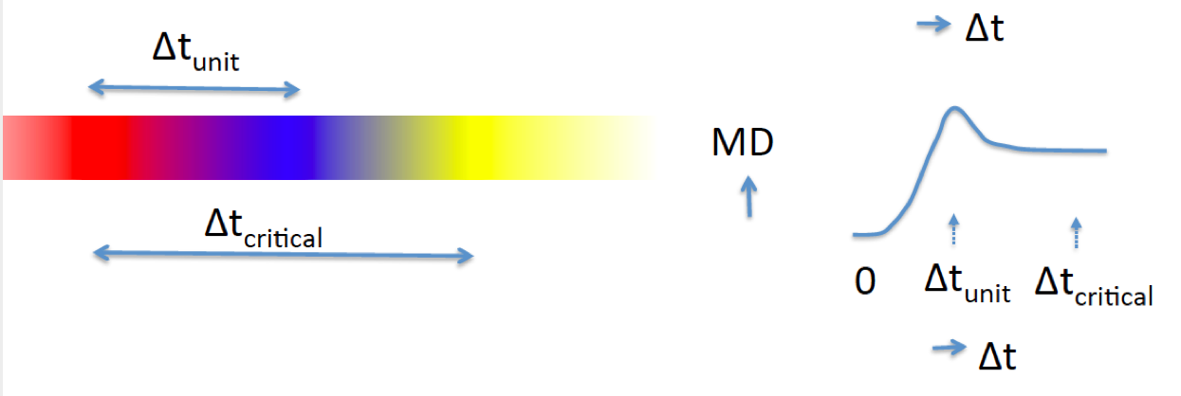
Evaluating Performance
How much sounds classes differ and how fast do they change?
Δi – time delay
D(.) – symmetric Kl divergence

Slide 12
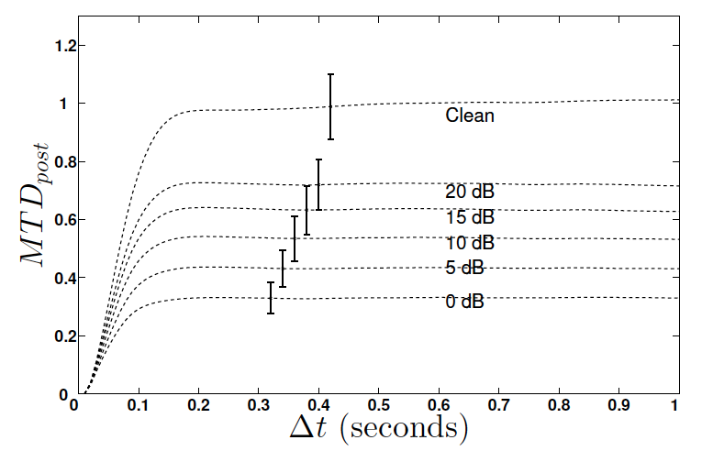
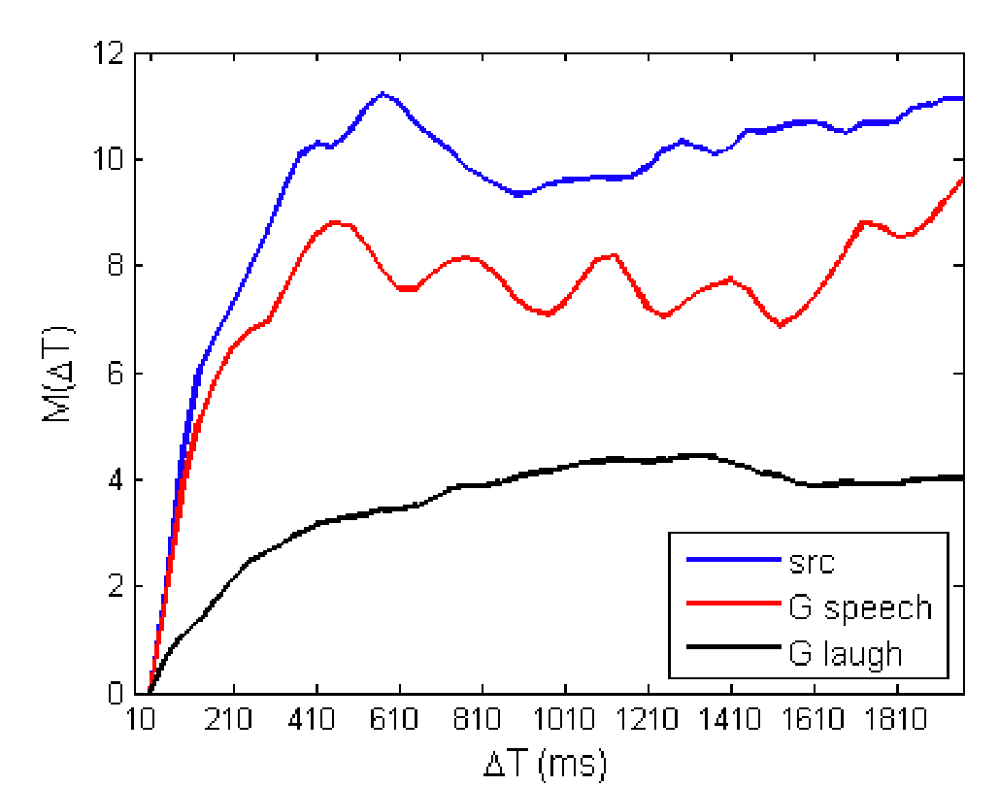
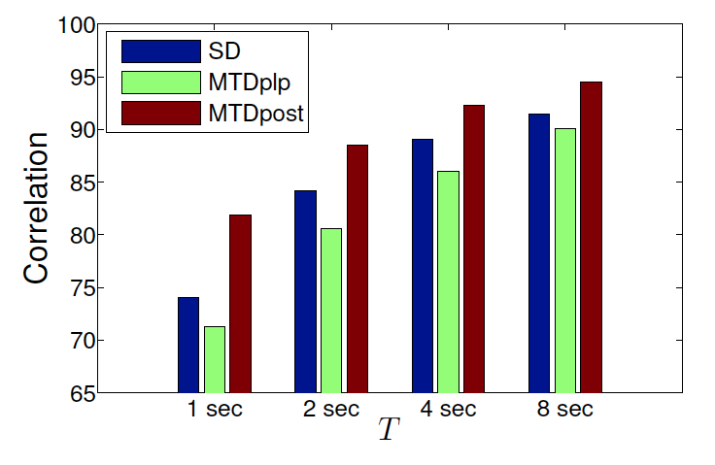
derived on all training data
derived on one sentence
length of interval for the estimation

Slide 13
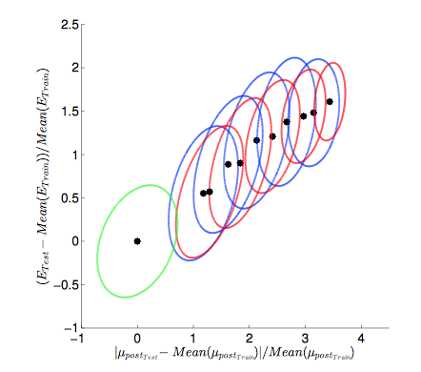
correlations between predictions of errors and true errors

Slide 14
neural network
estimating
posteriors of
speech sounds
signal
many nonlinear
processing
layers
estimate reliability from the output of the classifier
estimate reliability by comparing of values on hidden layers of the network

Slide 15
31 processing streams trained on band-limited data
clean TIMIT
TIMIT corrupted by random level subway noise
test results (39 phoneme posterior estimates and sentence-level phoneme accuracies) for 8 different noisy conditions for each processing stream

Slide 16
A Way of Dealing with Unknown Unknowns ?
EXTRACTED INFORMATION
Information in speech is coded in redundant dimensions.
Not all dimensions get corrupted at the same time.
performance
monitoring
stream
selection
strong
priors
weak
priors
&
Stream formation
Different perceptual modalities
Different processing channels within each modality
Bottom-up and top-down dominated channels
stream forming
analysis
SPEECH SIGNAL
Select only reliable streams for further processing

Slide 17
N parallel processing streams
Observed in
human recognition of frequency-limited and noisy speech sounds (Fletcher et al)
human recognition of words in and out of context (Miller et al, Boothroyd and Nittrouer)
Requires reliable identification of correct answers in processing streams (knowing when knowing)

Slide 18
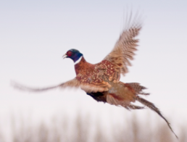
Monitoring Performance
P_{1hit}
P_{2hit}
P_{miss} = (1-P_{1hit})(1-P_{2hit})
observer - false positives and negatives are possible
P_{miss_observed} ≠ (1-P₁)(1-P₂)
Notes:
Just as animal knows when it is hit,
humans know when they do not get the correct information.
Speech is very redundant – create many different processing streams.
Each stream gets some information.
Machine – knows how it works on its training data
How close it is when applied in test?
Adaptation by leaving out corrupted processing streams.

Slide 19
sparse
100 %
dense
yes
no
judgement
decision
not sure
0 %
picture density
low
high
human judgment of density of pattern in a picture
(adopted from Smith et al 2003)
error
similar data available for monkeys, dolphins, rats,…
not sure

Slide 20
Multi-stream speech recognition Variani, Li and Hermansky 2013
Phoneme recognition error rates
environment | conventional | proposed | best by hand
clean (matched training and test) | 31 % | 28 % | 25 %
TIMIT with car noise at 0 dB SNR (training on clean) | 54 % | 38 % | 35 %

