Slide 1
MT as Cross-Lingual Parsing

Slide 2
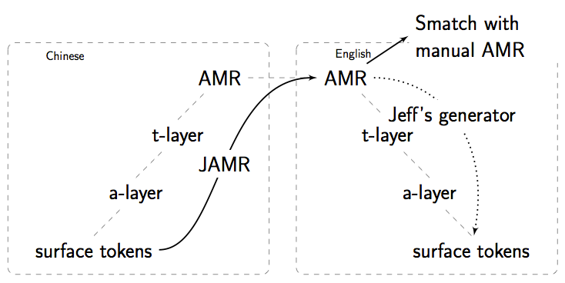
Overview of Cross-Lingual Parsing

Slide 3
Training JAMR
The tour was a surprise offer made by North Korea in November 2001.
(t / thing
:ARG0-of (s / surprise-01)
:ARG1-of (o / offer-01
:ARG0 (c / country
:name (n / name
:op1 “North”
:op2 “Korea”))
:time (d / date-entity
:month 11
:year 2001))
:domain (t2 / tour-01))

Slide 4
Need Alignments for Training JAMR
The tour was a surprise offer made by North Korea in November 2001.
(t / thing
:ARG0-of (s / surprise-01)
:ARG1-of (o / offer-01
:ARG0 (c / country
:name (n / name
:op1 “North”
:op2 “Korea”))
:time (d / date-entity
:month 11
:year 2001))
:domain (t2 / tour-01))

Slide 5
Mono-lingual parsing
Cross-lingual parsing
JAMR’s aligner uses:
  Edit distance based rules
  WordNet similarity
For cross-lingual parsing we need
  alignments from a source language string to target AMR concepts

Slide 6
Raw Parallel Corpus
Source Sentence
Target Sentence

Slide 7
Run Target-Side JAMR
Source Sentence
Target Sentence
Target AMR

Slide 8
Word Align Source-Target
Source Sentence
Target Sentence
Target AMR

Slide 9
Project to AMR
Source Sentence
Target Sentence
Target AMR

Slide 10
Training Data for cross-lingual Parser
Source Sentence
Target AMR

Slide 11
Experiment 2: Word Align to AMR Concepts
Source Sentence
EN-AMR Graph

Slide 12
Serialize Concepts
Source Sentence
EN-AMR Concepts
EN-AMR Graph

Slide 13
Align to AMR Concepts
Source Sentence
EN-AMR Concepts
EN-AMR Graph

Slide 14
Data Used
FBIS 300k Chinese-English parallel corpus
More Details
  Concept Table Extraction: 290k
  Concept Id Weights: 10k (stage 1)
  Relation Id Weights: 100 (stage 2)

Slide 15
他 最后 祝愿 李鹏 委员长 访问 各 国 取得 圆满 成功 。
Lastly he wished chairman li peng every success in his visit to the other countries .
Gold AMR
Output AMR
(w / wish-01
:ARG0 (h / he)
:ARG1 (s / succeed-01
:ARG0 (p / person
:name (n2 / name :op1 "Li"
:op2 "Peng")
:ARG0-of (h2 / have-org-role-91
:ARG2 (c / chairman)))
:ARG1 (v / visit-01
:ARG0 p
:ARG1 (c2 / country
:mod (o / other)))))
(c2 / chairman
:ARG1 (v / visit-01
:ARG1-of (s / succeed-01)
:ARG3 (c / country
:mod (o / other))
:prep-as (e / every))
:ARG1-of (w / wish-01
:ARG0 (p / person
:name (n / name
:op "peng"
:op "li"))))
Concepts from English side JAMR
Relations from Cross-lingual JAMR

Slide 16
他 最后 祝愿 李鹏 委员长 访问 各 国 取得 圆满 成功 。
Lastly he wished chairman li peng every success in his visit to the other countries .
Gold AMR
Output AMR
(w / wish-01
:ARG0 (h / he)
:ARG1 (s / succeed-01
:ARG0 (p / person
:name (n2 / name :op1 "Li"
:op2 "Peng")
:ARG0-of (h2 / have-org-role-91
:ARG2 (c / chairman)))
:ARG1 (v / visit-01
:ARG0 p
:ARG1 (c2 / country
:mod (o / other)))))
(s2 / say-01
:ARG0-of (w / wish-01
:ARG1 (a / achieve-01
:ARG0 (c / country
:location (a2 / all))
:ARG1 (s / succeed-01
:ARG1 (t / this))))
:ARG1 (l / last))
Concepts & Relations from Cross-lingual JAMR

Slide 17
Sample Output
# ::snt lastly he wished chairman li peng every success in his visit to the other countries .
# ::tok 他 最后 祝愿 李鹏 委员长 访问 各 国 取得 圆满 成功 。
#
(w / wish-01
:ARG0 (p / person
:ARG1-of (s / succeed-01
:ARG2 (v / visit-01
:ARG1 (c / country
:mod (o / other)))
:mod (e / every))
:name (n / name
:op1 "peng"
:op2 "li"))
:ARG1 (c2 / chairman))
AMR concepts from eng and relation from chinese sentence
(c2 / chairman
:ARG1 (v / visit-01
:ARG1-of (s / succeed-01)
:ARG3 (c / country
:mod (o / other))
:prep-as (e / every))
:ARG1-of (w / wish-01
:ARG0 (p / person
:name (n / name
:op "peng"
:op "li"))))

Slide 18
# ::snt lastly he wished chairman li peng every success in his visit to the other countries .
# ::tok 他 最后 祝愿 李鹏 委员长 访问 各 国 取得 圆满 成功 。
#
(w / wish-01
:ARG0 (p / person
:ARG1-of (s / succeed-01
:ARG2 (v / visit-01
:ARG1 (c / country
:mod (o / other)))
:mod (e / every))
:name (n / name
:op1 "peng"
:op2 "li"))
:ARG1 (c2 / chairman))
AMR concepts and relation from chinese sentence:
(s2 / say-01
:ARG0-of (w / wish-01
:ARG1 (a / achieve-01
:ARG0 (c / country
:location (a2 / all))
:ARG1 (s / succeed-01
:ARG1 (t / this))))
:ARG1 (l / last))

Slide 19
Future Work
Train stages with more data
Error analysis
Phrase alignment rather than heuristics over word alignment
More language pairs

