Slide 1
Towards machines, which know when they know and when they do not know
Hynek Hermansky
Johns Hopkins University
and
Brno University of Technology

Slide 2
speech
words
meaning
stochastic
recognizer

Slide 3
The Problem
estimator of posterior probabilities of speech sounds (phonemes)
signal
p_{i}
training data
Q: How good is the estimate?
can we believe the estimate ?
can we improve the estimate (unsupervised adaptation)

Slide 4
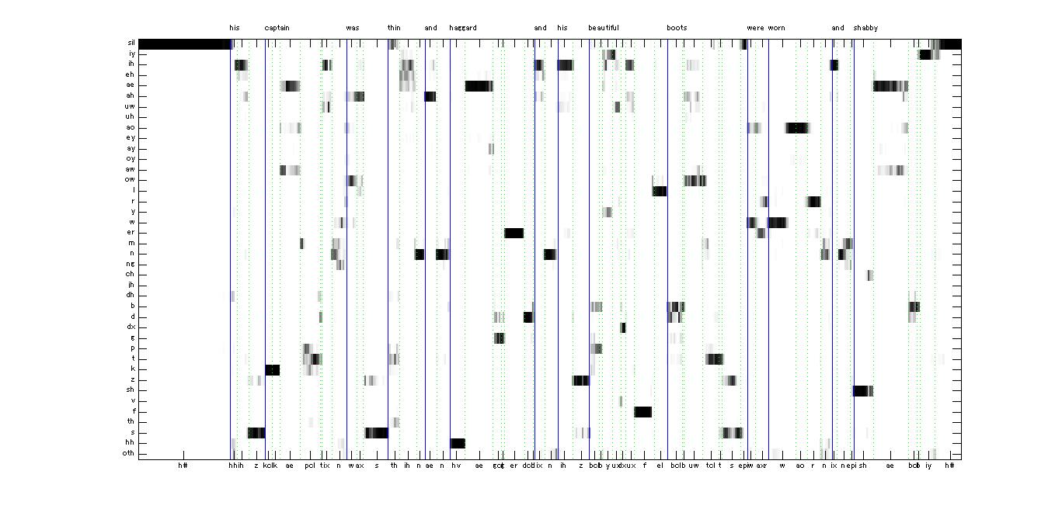
hierarchical deep neural network estimating posteriors of speech sounds
p_{i}
signal
(speech spectrum)
posteriogram (vectors of p_{i}s in time)
Do not know the correct answer (ground truth) but want to know
  How good or bad could be the result ?

Slide 5
hierarchical deep neural network
spectral band 1
DNN
spectral band 2
DNN
concatenate
posteriors from a given combination
speech
spectrum
spectral band 3
fusing
DNN
DNN
P_{i}
spectral band 4
DNN
spectral band 5
DNN
DNN – 4 hidden layer, estimating posteriors of context dependent states oh HMM and merging them to estimates of context independent phonemes
fusing DNN – 4 hidden layer, input are concatenated posteriors from the first stage DNNs, outputs are posteriors of context independent phonemes
training:
full combination (all frequency bands)
2 training conditions (clean speech and speech corrupted by broadband noise with varying SNRs)
test:
2⁵-1 = 31 possible combinations per training condition (all together 62 estimators)

Slide 6
Where could we get the necessary information?
from the output of the hierarchical DNN estimator
from data on hidden layers of the estimator
overall likelihood of the best sound sequence

Slide 7
evaluation criteria:
how well our measures correlate with
  errors in recognition of phoneme sequences ?
  comparisons with ideal posteriograms representing hand-labeled speech?
  comparisons with posteriograms derived from training-like data
ability to pick up the least corrupted stream in adaptive multi-stream system

Slide 8

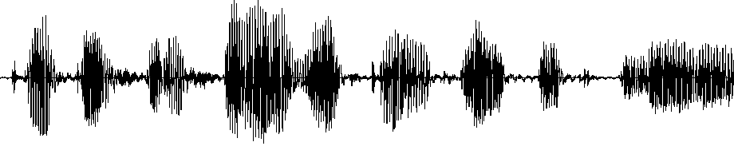
although
some
sort
of
the
computer
can
either
way
hopefully cin-cin o-bi computer connected with
Machines which know when they do not know !

Slide 9
He who knows not and knows not he knows not, he is a fool—shun him;
He who knows not and knows he knows not, he is simple—teach him;
He who knows and knows not he knows, he is asleep—wake him;
He who knows and knows he knows, he is wise—follow him!

Slide 10
Machines, which know when they know, and know when they do not know

