Slide 1
Deep, Long, and Wide Artificial Neural Networks in ASR
Hynek Hermansky

Slide 2
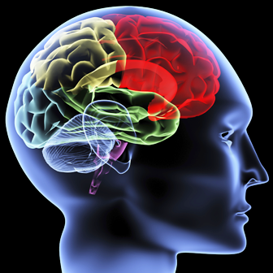
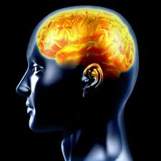
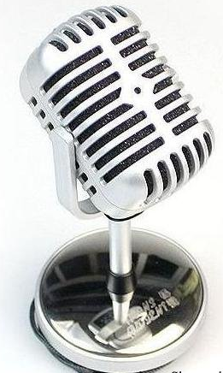
MEANING
MEANING
message
message
machine
sequence of speech sounds
(message)
machine
MEANING

Slide 3
speech signal
estimate likelihoods p(x|W_{i}), where W_{i} are constituents of W (speech sounds)
stochastic search
Ŵ = argmax_{W} p(x|W) P(W)
language model and lexicon
w
eh
k
s
oh
f
aa
r
t
aa
r
b
ei
s
t
sil
works
of
art
are
based
sil

Slide 4
Multi-Layer Perceptron can emulate any nonlinear mapping
MLP
likelihood of speech sound
cicada
human
~ 10⁶ neurons
~ 10¹¹ neurons
sensory organ
central
nervous
system
central
nervous
system
sensory organ

Slide 5
EXTRACTED INFORMATION (10 Hz)
spectro-temporal analysis
(cortex)
10 M
number
of
neurons
10 Hz
descending
auditory
pathway
ascending
auditory
pathway
speed
of
firing
100K
1 kHz
spectral analysis
(cochlea)
STIMULUS (10 kHz)

Slide 6
Multi-Layer Perceptron can emulate any nonlinear mapping ☺
MLP
likelihood of speech sound
IN
OUT
(given infinite size of the MLP and an infinite amount of training data ☹ )_
Combinations of MLPs can emulate useful nonlinear mappings
and perhaps can do it more efficiently
prewired
mapping
based on
previous
knowledge
(features)
IN
OUT

Slide 7
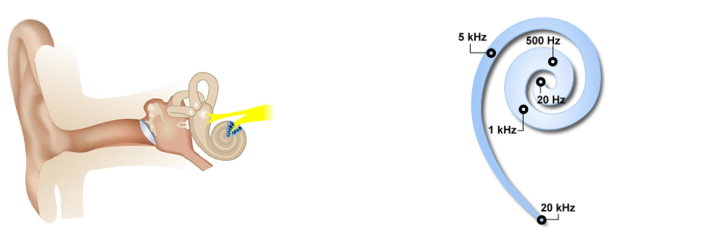
hearing periphery
cochlear frequency
analysis
hair cell one-way
rectification
time
spectral
analysis
frequency
time

Slide 8
time-frequency representation of the signal
(spectrogram)
frequency
ω₀
time
short-term spectral slice P(ω,t₀)
t₀
temporal evolution of spectral energy P(ω₀,t) in frequency bands
Which frequency bands ?

Slide 9
Simultaneous Masking (Fletcher 1940)
band-pass filtered
noise centered at f
what happens outside the critical band does not affect decoding of the sound in the critical band
tone at f
critical
bandwidth
threshold of
perception
of the tone
noise bandwidth
Notes:
Original experiments that revealed existence of critical bandwidth were masking experiments where a tone of a certain frequency was masked by band-pass filtered noise with varying bandwidth, centered on the frequency of the probe. The masking increased with the increasing bandwidth of the noise, up to certain noise bandwidth, after which the masking did not increase anymore. More noise energy is being added but it has no effect on the detection of the probe anymore!

Slide 10
Simultaneous (frequency) masking
critical
bandwidth
10000
threshold of
perception
of the tone
5000
2000
1000
critical bandwidth [Hz]
500
100
noise bandwidth
50
50
100
500
1000
5000
10000
frequency [Hz]
Better frequency resolution at lower frequencies
also seen in
growth of loudness
perception of subthreshold stimuli
Sound elements outside a critical band do not corrupt decoding of elements inside the band

Slide 11
Linear Discriminant Analysis (LDA)
1D-data space
A
Linear discriminants: eigenvectors of
Σ⁻¹_{W}Σ_{B}
B
2D-data space
Σ_{W} - within-class covariance matrix
Σ_{B} - between class covariance matrix
A
B
direction of maximal discriminability
Needs labeled data

Slide 12
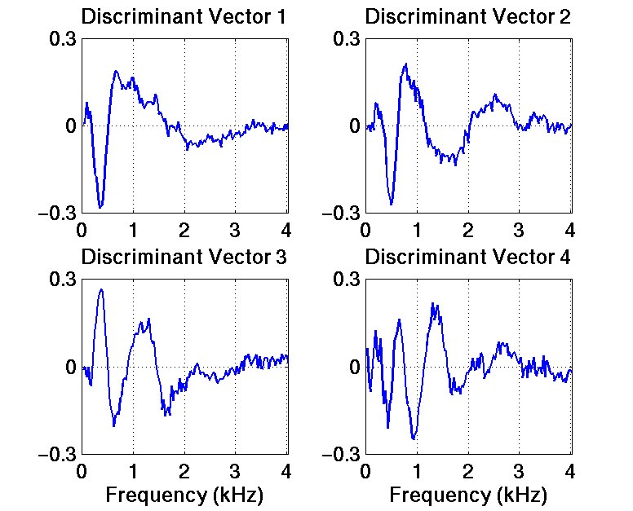
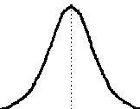
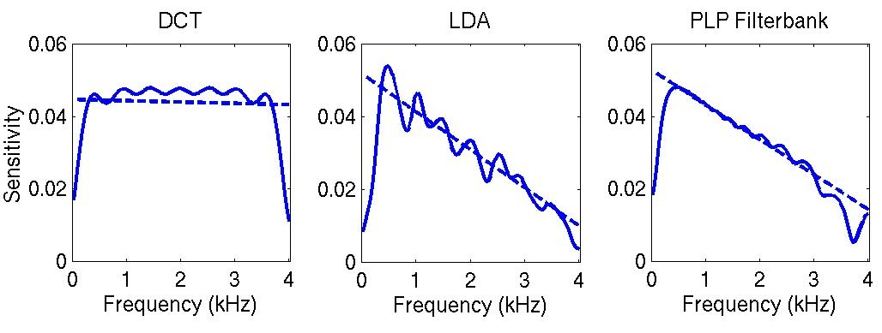
δf=30 Hz
63 %
16 %
first 16
LDA basis
?
f
Cosine basis LDA-derived basis Critical-band filterbank
12 %
2 %
Malayath and Hermansky 2003, Valente and Hermansky 2006
Better frequency resolution at lower frequencies is desirable

Slide 13
Better frequency resolution at lower frequencies
Sound elements outside a critical band do not corrupt decoding of elements inside the band
HOW LONG ?
conventional
~ 10 ms
processing
frequency
processing
frequency
processing
processing
time
time

Slide 14
Masking in Time
masker
increase
in threshold
signal
stronger masker
τ
time
0
τ
200 ms
suggests ~200 ms buffer in auditory system
also seen in perception of loudness, detection of short stimuli, gaps in tones, auditory afterimages, binaural release from masking, …..
Sound elements outside this buffer do not affect detection of signal within the buffer

Slide 15
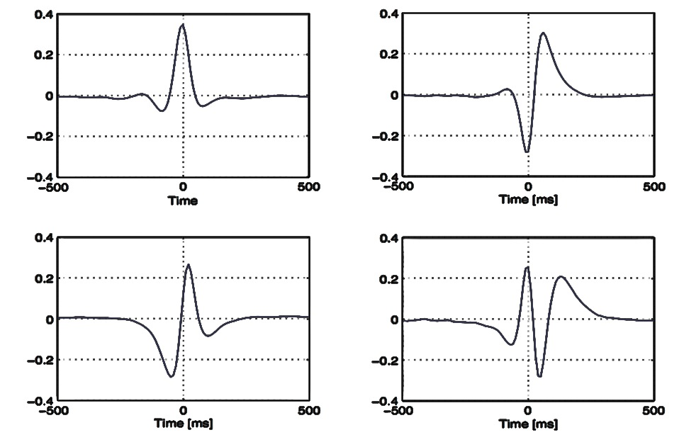
LDA on temporal trajectories of spectral energies
impulse responses
frequency responses
(1st discriminant in all frequency channels)
77%
10%
0
higher carrier
frequencies
attenuation [dB]
10
-500 0 500
-500 0 500
20
0.1
1.0
10.0
modulation frequency [Hz]
7%
2%
-500 0 500
-500 0 500
time [ms]
time [ms]

Slide 16
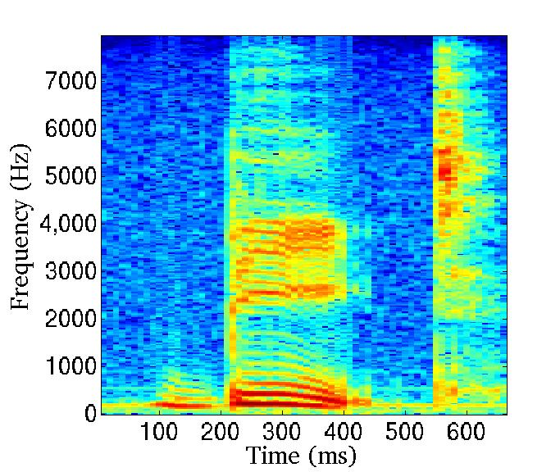
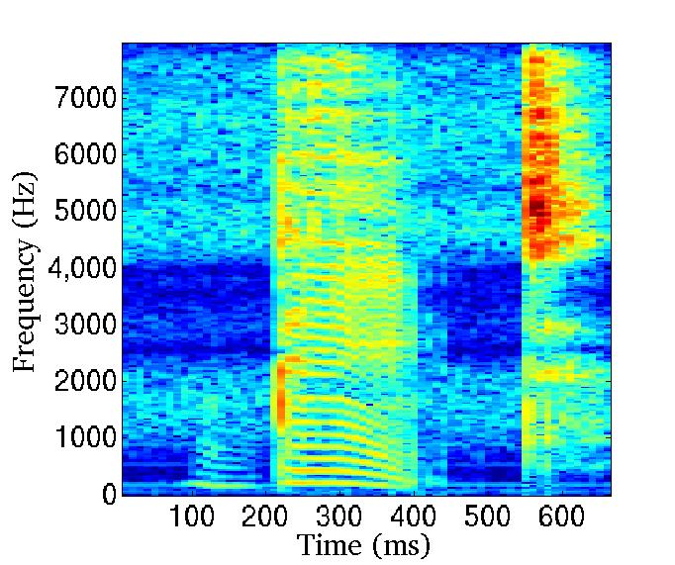
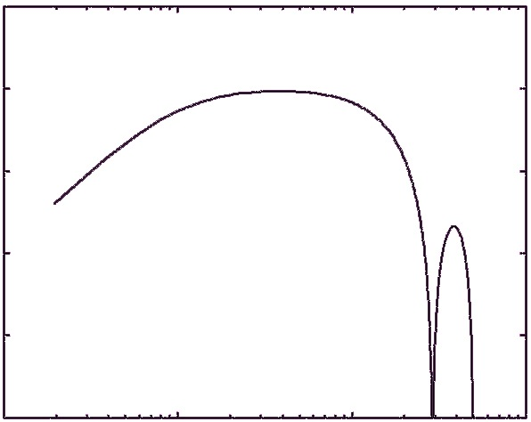
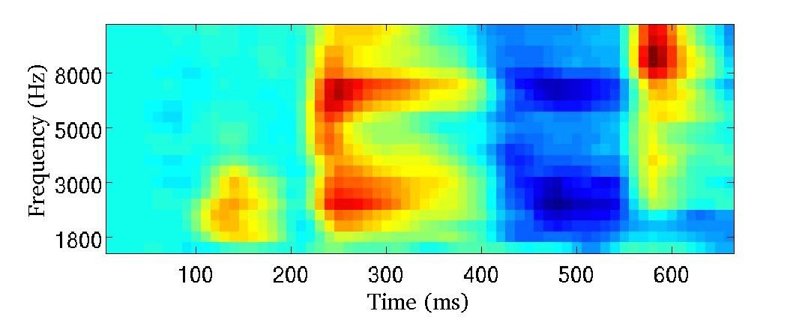
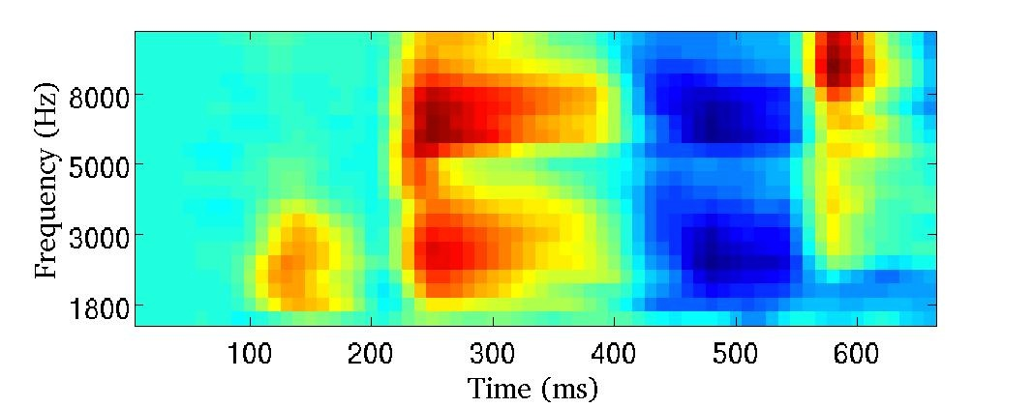
RASTA
original speech
filtered speech
Filter each critical band output by a band-pass filter
spectrogram
frequency response
10
attenuation [dB]
frequency
spectrogram from RASTA
-40
1
10
modulation frequency [Hz]
time
pass modulations between 1-15 Hz
Environmental mismatch in training and in test
 | matched | mismatched
conventional | 2.8 % error | 60.7% error
RASTA | 2.2 % error | 2.9 % error
Notes:
Jordy Cohen and his inverse vowel problem
Phil Kohn - color perception - reintegrate derivative
Add feedback loop to delta regression - IIR filter.
Optimization - peak around 4 Hz and >200 ms time constant.
RASTA name and Rastafarians
Saved my life at U S WEST !

Slide 17
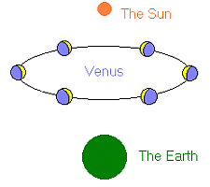
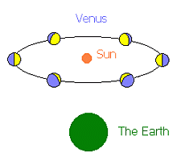
Lesson From History
Galileo
Ptolemy
Notes:
It is better to se large part of an animal to decide what it is.
Spectrograph - meaning of spectral slices?
(Also linear frequency scale because of heterodyne)
Coarticulation "problem"?
Simultaneous masking - remote spectral components do not influence detection in critical band.
Spectral envelope must be wrong!
Felt like Galileo. Had data which do not fit the concept!

Slide 18
Ear is frequency selective
NOT in order to derive spectrum of the signal
but
in order to yield frequency-localized temporal patterns.

Slide 19
Frequency Domain Linear Prediction (FDLP)
FDLP
means for all-pole estimation of Hilbert envelopes (instantaneous spectral energies) in individual frequency channels
preprocessing
autoregressive
model
PLP spectrum
speech signal
t₀
t₀
time
frequency
cosine
transfrorm
time
FDLP estimate
of Hilbert
envelope
autoregressive
model
f₀
frequency
frequency
time
f₀

Slide 20
200-400 ms
processing
classifier
frequency
processing
classifier
merging
processing
classifier
time

Slide 21
about 7 ms
about 200 ms
time
> 200 ms
classifier

Slide 22
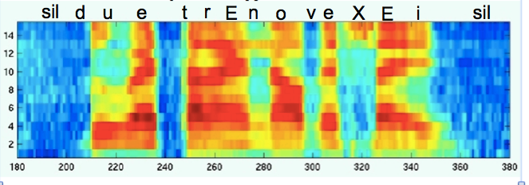
Information in speech is coded hierarchically (deep)
in temporal dynamics (long)
and in many redundant dimensions (wide)
Deep, Long, and Wide Neural Nets
many
processing
layers
up to 1000 ms
get
info₁
(transformed)
posterior
probabilities
of speech
sounds
in the center
of the window
frequency
get
info_{i}
fusion
get
info_{N}
time

Slide 23
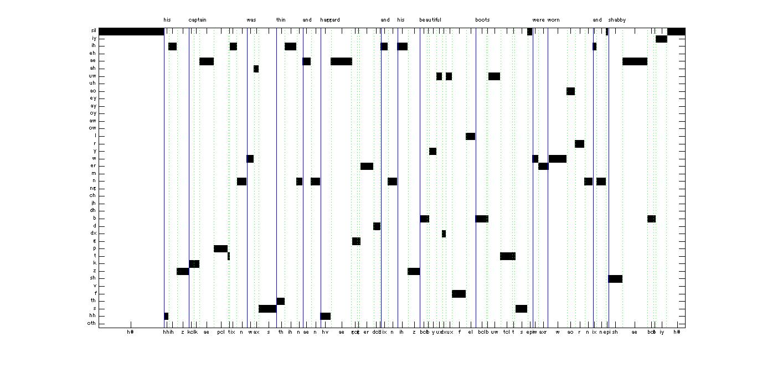
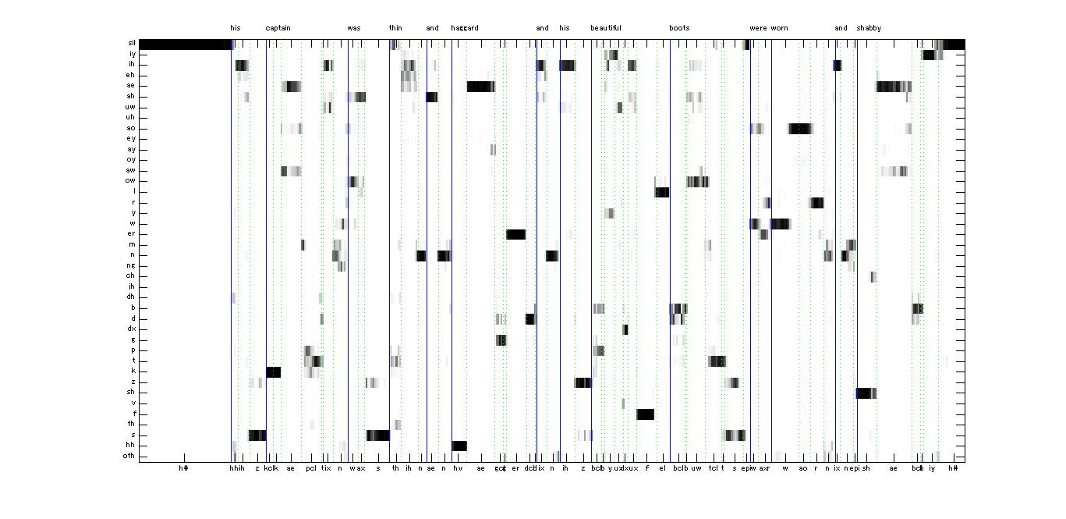
Labels
Long, wide and deep ANN estimates
thanks Tetsuji Ogawa

Slide 24
Information in speech is coded in many redundant dimensions.
Not all dimensions get corrupted at the same time.
get
info₁
probability
estimator
posterior
probabilities
of speech
sounds
speech
signal
get
info_{i}
probability
estimator
smart
fusion
get
info_{N}
probability
estimator
Smart fusion – alleviates unreliable processing streams
Probability estimator, which knows when it does not know

Slide 25
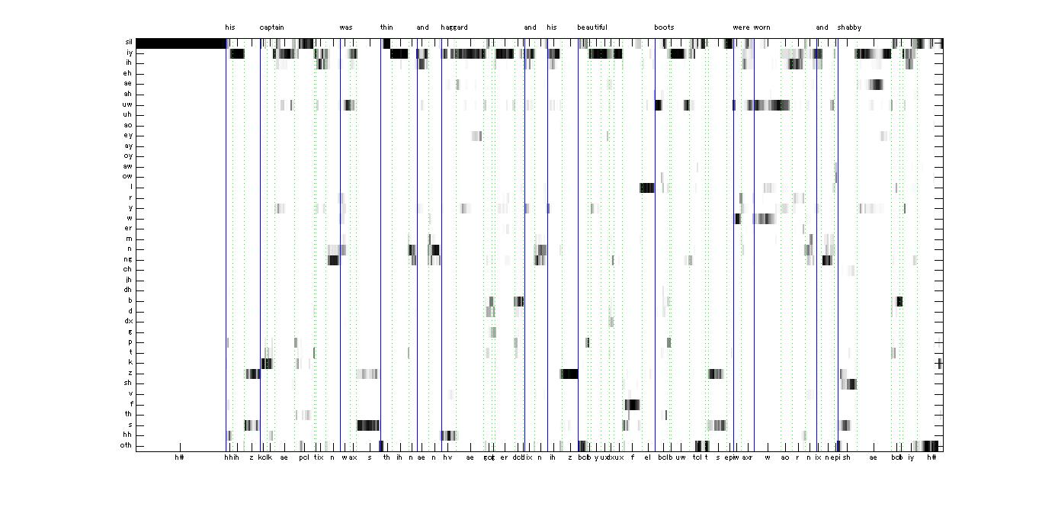
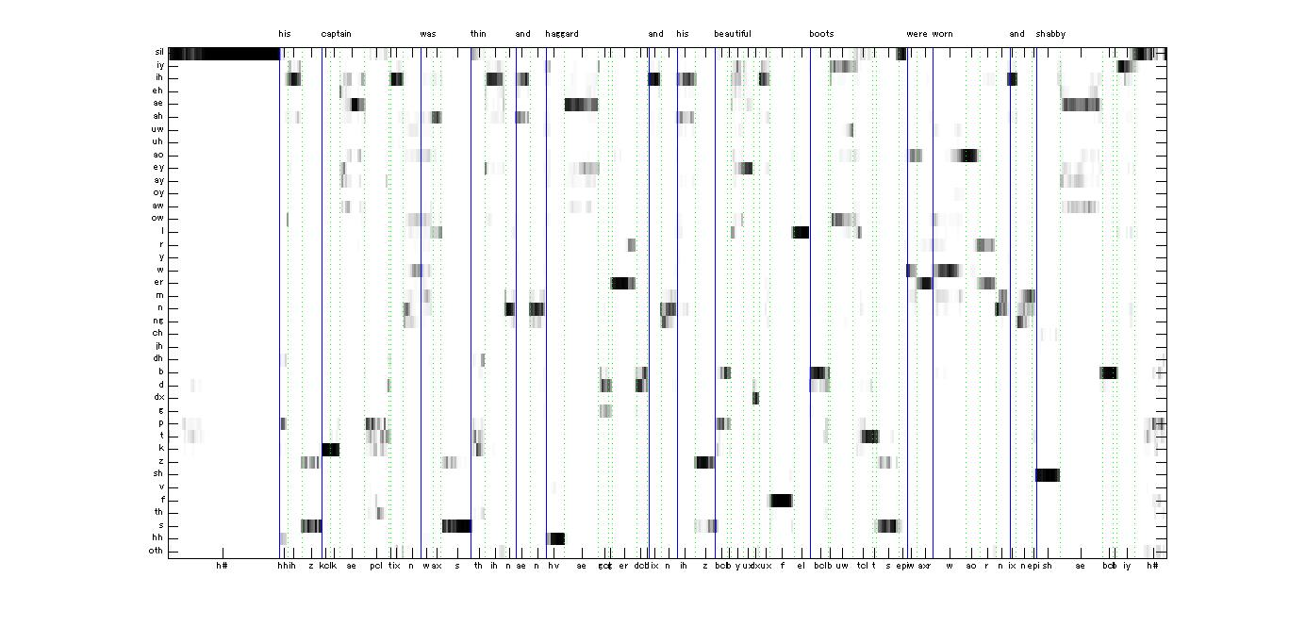
clean
corrupted by -20 dB SNR 1 kHz sinusoidal signal
performance monitoring selecting less corrupted parts of the signal
thanks Tetsuji Ogawa

Slide 26
Multi-stream speech recognition Variani, Li and Hermansky 2013
Phoneme recognition error rates
environment | conventional | proposed | best by hand
clean (matched training and test) | 31 % | 29 % | 24 %
TIMIT with car noise at 0 dB SNR (training on clean) | 54 % | 35 % | 30 %
RATS data (Channel E – matched training and test) | 70 % | 54 % | 49 %

Slide 27
Conclusions
Inputs to each local Deep Neural Net (DNN) should be frequency localized
Data to each local DNNs should cover larger than 200-300 ms time spans
Fusion from local DNNs should be done in a way that alleviates unreliable processing on local DNN levels

Slide 28
Arguments Against Short-Term Frequency Spectrum?
Simultaneous masking: Sound elements outside a critical band do not corrupt decoding of elements inside the band
Temporal masking: Sound elements outside a critical interval (about 250 ms) do not corrupt decoding of elements inside the interval
Jont Allen’s interpretation of earlier works of Fletcher et al at the 1993 Summer Workshop at Rutgers University
Human listeners recognize speech in independent frequency bands
Notes:
It is better to se large part of an animal to decide what it is.
Spectrograph - meaning of spectral slices?
(Also linear frequency scale because of heterodyne)
Coarticulation "problem"?
Simultaneous masking - remote spectral components do not influence detection in critical band.
Spectral envelope must be wrong!
Felt like Galileo. Had data which do not fit the concept!

Slide 29
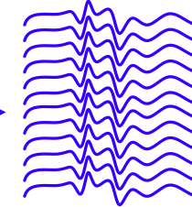
spectral
analysis
Hilbert envelopes
in spectral bands
multi-layer
perceptrons
WIDE
(multiple
processing
streams)
posterior
probabilities
of speech
sounds
LONG
(200-400 ms)
DEEP
(hierarchical structures
of multi-layer perceptrons)

Slide 30
Fletcher and colleagues (1920-1950)
nonsense CV,VC, and CVC in carrier sentences, well-trained listeners
low-pass and high-pass filtering
varying SNR
high SNR
low SNR
100%
minimal error = 1.5%
high-passed
equal error
probability
of correct
recognition
of phoneme
minimal error >> 1.5 %
low-passed
equal error
0%
frequency
frequency

Slide 31
Make the equal error at 0.5
0.985
1
s
probability
of correct
recognition
log(1-s)
0.5
log (0.05)
0
0
transformation
Since (1-s) = p(error), the logarithms of probabilities of errors are additive, i.e.
makes the contributions from high and low band additive for all conditions
True for up to 20 bands

